Slide 1


06/2026

Slide 2
What is salary deferral?
Salary Deferral is a voluntary payroll authorization that salaried employees who are paid on an academic year contract, may request.
When an employee signs up for salary deferral, a percentage of salary is deducted each payroll during the academic year and repaid during the summer months.
This process allocates an academic year contract over the fiscal year.

Slide 3
What are the benefits of salary deferral?
If you have an academic year contract, you are paid over 9 months and will have no pay in the summer for that contract.
If you use salary deferral your pay will be allocated over 12 months and you will continue to receive pay during the summer for this contract.
If you have pay during the summer months, your insurance premiums can continue as pre-tax deductions and other payroll deductions can continue. Without salary deferral you will need to pay your insurance premiums.
This feature allows you to have a constant income stream.

Slide 4
How do I sign up for salary deferral?
You must complete a Salary Deferral Authorization Form found on the Human Resources forms page:
http://www.siue.edu/humanresources/forms/
Scroll down to Salary Deferral and select the Salary Deferral Authorization Form.
Complete the form and submit it to Payroll in Human Resources.
The form may be printed and mailed to Payroll, Campus Box 1040, or faxed to 618-650-2696, or completed on-line and saved as an attachment and then e-mailed to Payroll at payrollhr@siue.edu.
Payroll will e-mail you a confirmation receipt near the end of July.

Slide 5
An example of salary deferral
If your Salary is = $2,389.00 / per payroll (9month /paid over 18 pay periods)
25% of your gross pay each pay period during the Defer Pay In period (the academic year) is set aside for the Defer Pay Out period (summer)
Gross pay less defer pay (earn code 100) = $ 1,791.75 / per pay period
Defer pay (earn code 130) = $ 597.25 / per pay period
Your gross pay will be $1,791.75 each pay period during the academic year and your defer pay deduction will be $597.25 for 18 pay periods and will accumulate to $10,750.50.
This amount will be paid during 6 payrolls over the summer or $1,791.75 per payroll. When you sign up for salary deferral, these amounts are displayed on your earnings statement.
There is also an on-line calculator to help you determine the impact on your pay:
https://www.siue.edu/human-resources/payroll/def-pay-calculator.shtml

Slide 6
Are there deadlines to sign up for salary deferral?
Yes, the Internal Revenue Service establishes guidelines for salary deferral and requires that Authorization Forms be submitted before employees begin their first day of employment for the academic year for which salary deferral is to begin.
The Salary Deferral Authorization form must be received in time by Payroll in Human Resources.

Slide 7
Can I sign up late, after I begin Employment?
No, the Internal Revenue Service (IRS) establishes guidelines for salary deferral and requires that Salary Deferral Authorization Forms be submitted before employees begin their first day of employment for the academic year for which salary deferral is to begin.
The university must follow the IRS guidelines.

Slide 8
What if I changed my mind, can I
No, once the decision is made to authorize salary deferral, it is irrevocable for the academic year and you may not opt out, per IRS guidelines.

Slide 9
When and how can I stop salary deferral?
To stop salary deferral, you must complete a Salary Deferral Revocation Form found on the Human Resources forms page:
http://www.siue.edu/human-resources/forms/index.shtml
Scroll down to Salary Deferral and select the Salary Deferral Revocation Form.
Complete the form and submit it to Payroll in Human Resources.
The form may be printed and mailed to Payroll, Campus Box 1040, or faxed to 618-650-2696, or completed on-line and saved as an attachment and then e-mailed to Payroll at payrollhr@siue.edu.
The form must be received by Payroll before the first day of employment for the year in which you wish to stop.

Slide 10
Do I have to complete a Salary Deferral Authorization Form each year?
No, you do not need to complete a new form each year.
Your Salary Deferral Authorization will remain in effect year to year unless you submit a Salary Deferral Revocation Form prior to the start of your next year’s contract.

Slide 11
What happens if my contract changes?
If you are on an academic year contract and change positions to a fiscal year contract, your salary deferral balance will be paid to you in one lump sum.
If your appointment percent drops below 50% your salary deferral balance will be paid to you in one lump sum.
You must authorize salary deferral again when/if your contract terms are eligible for salary deferral.

Slide 12
What happens if I terminate before the end of the fiscal year?
In the event of a separation from service before the end of the 12 month payment period, you will be paid the accumulated amount from your defer pay as a lump sum.

Slide 13
What happens if I go on medical leave before the end of the fiscal year?
Medical leave is not the same as termination, so you will not be paid out a lump sum.
If you continue to be in pay status during the medical leave, the salary deferral process will continue and the deduction will be taken.
If you run out of paid leave time, your salary deferral deduction will not be taken and the amount of your payback will be reduced.
If you are still on leave during the summer, your defer payback will begin.

Slide 14
Is Salary Deferral the same thing as the State of Illinois Defered Compensation 457 Plan?
No, Salary Deferral is administered by Payroll in Human Resources at SIUE.
Salary deferral is compensation earned in one year and paid in a future year and falls under IRS Section 409A guidelines.
The State of Illinois Deferred Compensation 457 Plan is a Supplemental Retirement Plan which requires you to enroll and select investment choices.
The link to more information on Supplemental Retirement accounts: https://www.siue.edu/human-resources/benefits/retirement-financial-planning/deferred-compensation-457.shtml

Slide 15
If I participate in salary deferral can I still participate in the other Supplemental Retirement Accounts – 403b and 457?
Yes, you may participate in either or both of the Supplemental Retirement Accounts; the SIUE 403b Plan or the State of Illinois Deferred Compensation 457 Plan.
Annual limits are enforced for both.
For more information view Supplemental Retirements at:
https://www.siue.edu/human-resources/benefits/retirement-financial-planning/supplemental-retirement-plans-403b.shtml

Slide 16
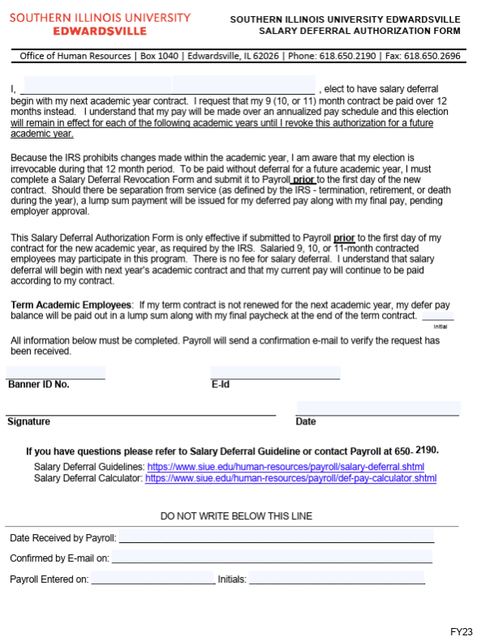

Slide 17
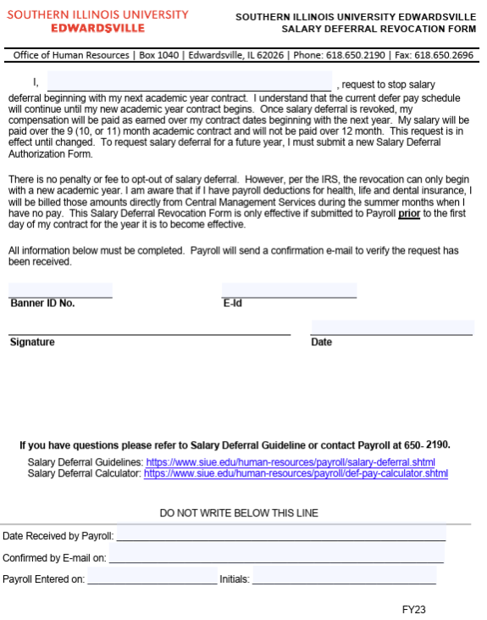

Slide 18
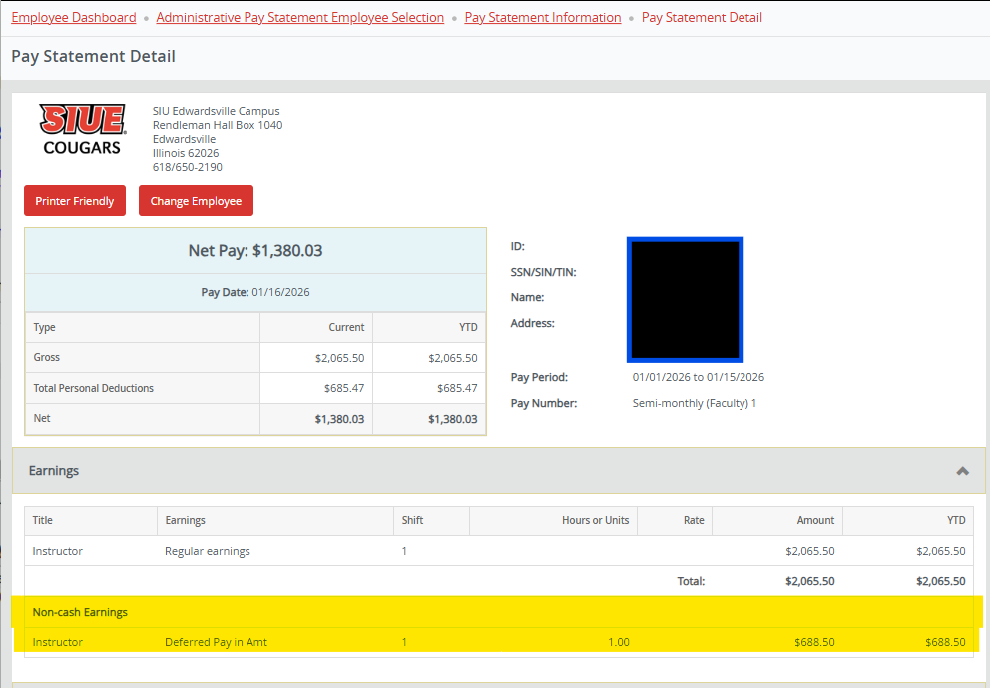
How can I tell if I signed up for Salary Deferral?
You can view this on your pay statement on Cougar Net.
The “Deferred Pay in Amt” means this employee signed up for Salary Deferral.

Slide 19
Where can I go for more help?
If you have questions about Salary Deferral, please contact Payroll at 618-650-2190 or by e-mail to Payroll at payrollhr@siue.edu.
Visit the Payroll Salary Deferral website which contains links to the Salary Deferral Guidelines, Forms, FAQ’s and online calculator:
http://www.siue.edu/human-resources/payroll/salary-deferral.shtml
You may also review the IRS information at irs.gov

