Slide 1
Instructor Presence and Promoting Engagement
Introduction
Jonathan Coons – Instructional Designer
ITS – Instructional Design & Learning Technologies
Notes:
Hello, and thank you for joining us today.
We are going to discuss instructor presence and promoting engagement.
These topics are important because they directly effect the student learning experience.
After this presentation I hope you will consider implementing some of these suggestions in your courses. As always, IDLT is available to assist should you have further questions.

Slide 2
Faculty Summer Camp for Moving Online Series
6/22 - Why Online is Different (Dr. Melissa Thomeczek, Matt Schmitz)
6/23 - Making a Plan for Your Course (Jennifer Albat)
6/24 - Organizing Your Course (Jodie Nehrt)
6/25 - Instructor Presence and Promoting Engagement (Jonathan Coons)
6/26 - Designing for Accessibility (Angie Beyer)
Notes:
As a reminder, this webinar is part of a week-long series for moving online. Please join us for the remainder of the sessions. Each session will be recorded and placed in the IDLT webinar archives.

Slide 3
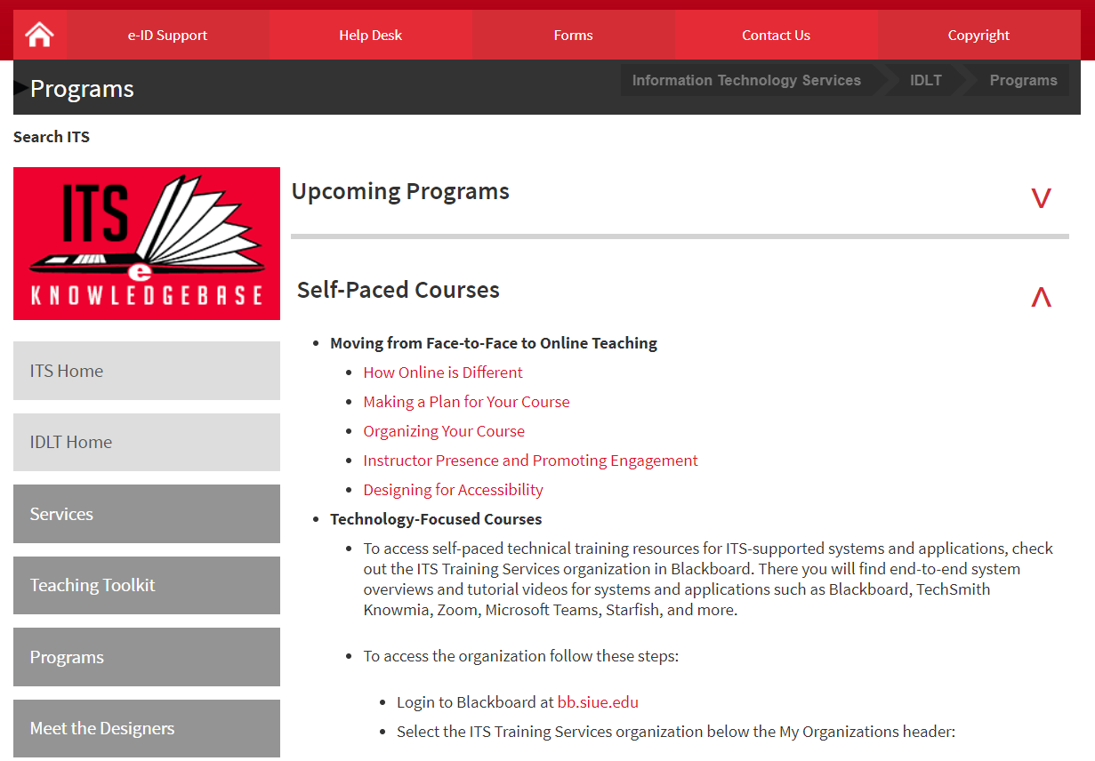
https://www.siue.edu/its/idlt/programs/index.shtml
Notes:
Also, each session has been developed as its own self-paced course on our website.

Slide 4
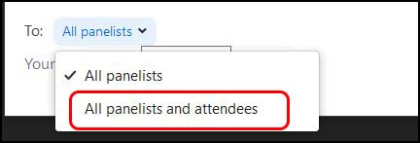
Introduction
Notes:
To get started, let’s go over the features of the webinar. First, there’s the chat. When using the chat, be sure your messages are going to the intended recipients. The default is to all panelists. Change the drop-down so that it goes to all panelists and attendees if you want everyone to see it. Let’s practice that now. Say hello to everyone. Remember to say it to all panelists and attendees.
Pause Okay, thanks for practicing that. Jennifer will be helping us out today and monitoring the chat.
The next feature is the Q&A. Please use this feature to ask questions. This can be answered more formally anytime throughout the presentation as questions can really get lost in the chat. We have Jodie helping out with the Q&A today.
The final feature is the raise hand feature. At the end the webinar I’ll take questions from the audience. Use the raise hand feature so we can turn on your audio to ask the question live.
Okay let’s get started.

Slide 5

Introduction
Tone
Flexibility
Organization
Outreach
Notes:
To get right into it…
When you think about Instructor Presence and Promoting Engagement, I want you to remember these four pillars.
Tone: the general character or attitude of a place, piece of writing, situation, etc.
Flexibility: willingness to change or compromise
Organization: an efficient and orderly approach to tasks
Outreach: reach further than
Each pillar is an important principle or concept by itself. However, when used together, they function as a sort of prism that can help you reimagine your approach to online learning.

Slide 6
About This Course / Start Here

Slide 7
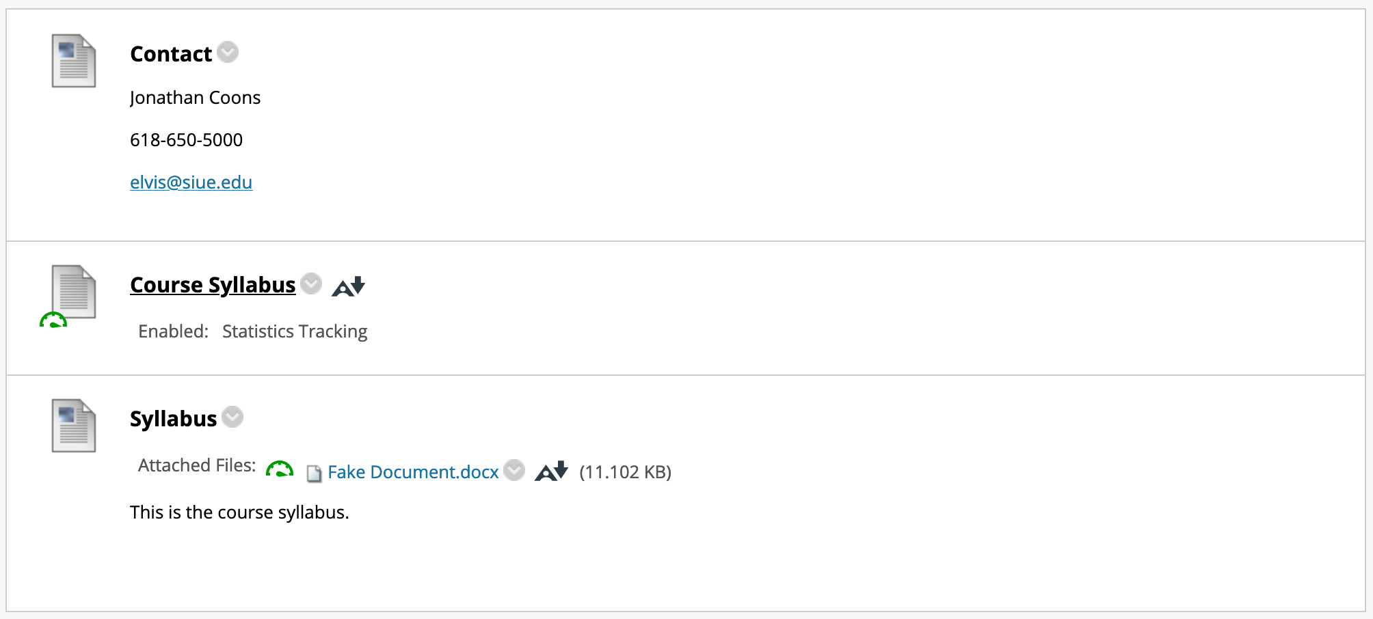
Notes:
Let’s look at what a basic “About This Course” might look like. Here you can see contact information, a course document, and a syllabus linked as a word file. Something like this is common. Unfortunately, this is lacking in instructor presence, and it is not engaging for students.

Slide 8
Start Here Content Area
Flexibility
Allow Multiple Contact Methods
Prompt Learners to Practice Communication
Tone
Greet Them Personally
Emphasize Communication
Share Something Exciting
Organization
Include a Steppingstone
Make it a Splash Page
Outreach
Share Your Expertise
Introduction Activity
Conduct a Pre-Course Survey
Notes:
So how can you incorporate Tone, Flexibility, Organization, and Outreach into your About This Course?
Well, make it a… ”Start Here”.
A well designed Start Here Content Area is a package that contains all the information that learners need to get started immediately. It is a powerful tool to set the stage for everything that may follow.
What are some of the major elements to include in a Start Here?
Tone:
First, consider using Techsmith Knowmia to create an introduction video. A video provides learners with a direct initial opportunity to form an idea of who you are. These videos do not need to be perfectly perfect, but you can welcome learners, stress the benefits of communication, emphasize how planning and routine are essential to their success, and most importantly, share something that you think they will be excited about doing as they work through the course.
Link: https://kb.siue.edu/94105
Flexibility:
Practice with technology helps ease learner's anxiety.
Organization:
Another great addition is a Steppingstone. A steppingstone organizes the specific things learners should do first into one item. It contains documents like, the syllabus, directions to an introduction activity, and what and where they should go to begin the instructional content.
Link: Jodie’s Presentation
Outreach:
Consider adding a pre-course survey. A pre course survey can help you identify prior knowledge that learners have, before working with the content. It can also help you identify those learners that may need additional help, if for example, they indicate that they don’t have plans for how they are going to be successful in the course. This can help you tailor content to the greatest effect.
Link: https://kb.siue.edu/56888
Elements like these work together to help you lower student anxiety and increase potential learning in your course.

Slide 9
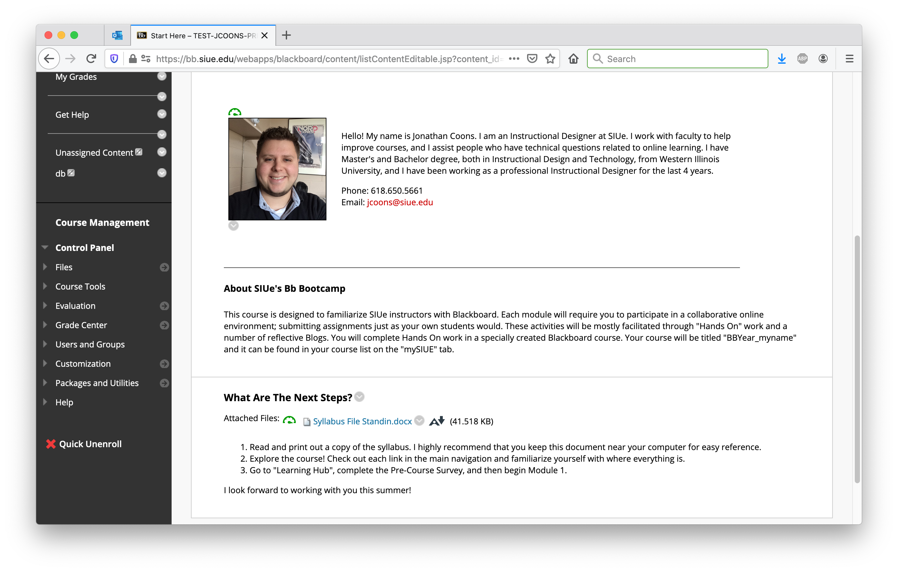
Notes:
Here is an example of what a Start Here Content Area that incorporates some of these suggestions might look like. Please look and then share in the chat what you might do differently.

Slide 10
Lectures

Slide 11
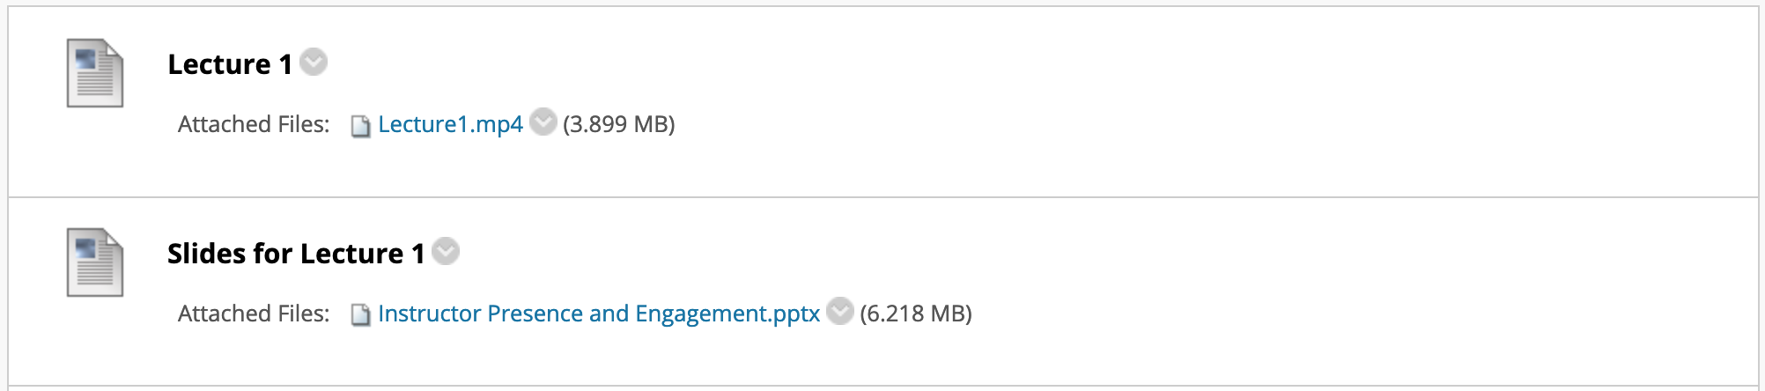
Notes:
Initially, lectures are often inserted as a content dump. This can be a good way to start, but it is only the beginning.

Slide 12
Lectures
Flexibility
Make Content ”Digestible”
Tone
Tell Germane Stories and Use Germane Images
Organization
“Nestle” Content
Embed Videos
Outreach
Caption Videos
Alt Text for Images
Notes:
So how can you look through the “prism” of tone, flexibility, organization, and outreach to modify lectures?
Tone:
Consider whether content that you are adding is “germane”. Germane means “relevant to a subject under consideration”. Telling relevant stories and using germane images directly influences how students perceive you. Adding fun graphics does little to add to the learning experience if it is not relevant. Think carefully about how you add these elements because when images and/or stories are not relevant, even if you think they are interesting, they can have an overall effect that depresses potential learning.
Link: No Link.
Flexibility:
One of the advantages of online delivery is that content can be delivered in “digestible” chunks. This is advantageous for two reasons. First, it forces you to focus more on specific topics, and second, it helps people with busy schedules digest content because they can apply themselves more to the specific topic at hand while interacting with it. Ideally lecture videos on a specific topic should be about 4 to 10 minutes in length. If you need to edit videos that you have already made you can do that with Techsmith Knowmia.
Edit Videos in Techsmith Knowmia KB Link: https://kb.siue.edu/94040
Organization
To nestle means to “settle or lie comfortably within or against something”. Often web videos and lectures are placed in a Blackboard course by themselves. However, videos can be nestled in-between other content by using what is called an “embed code” and doing that can help give those videos important context that may otherwise be absent. Embedding the video is nicer for learners because they don’t have to navigate out to another website. Similarly, if you are using using PowerPoint with your lecture, you can place it next to the video.
Embed Videos using Techsmith Knowmia KB Link: https://kb.siue.edu/94046
Outreach:
Once a video is uploaded to TechSmith Knowmia, captions can be generated and published on the video. This can be an advantage for all students. For example, consider a student who only has time to watch lecture videos late at night. In this situation, the fact that videos are captioned would give them an opportunity to learn without disturbing others.
Caption Videos in Techsmith Knowmia KB Link: https://kb.siue.edu/94007
Similarly, Finish!
Blackboard Ally Link: https://kb.siue.edu/81214

Slide 13
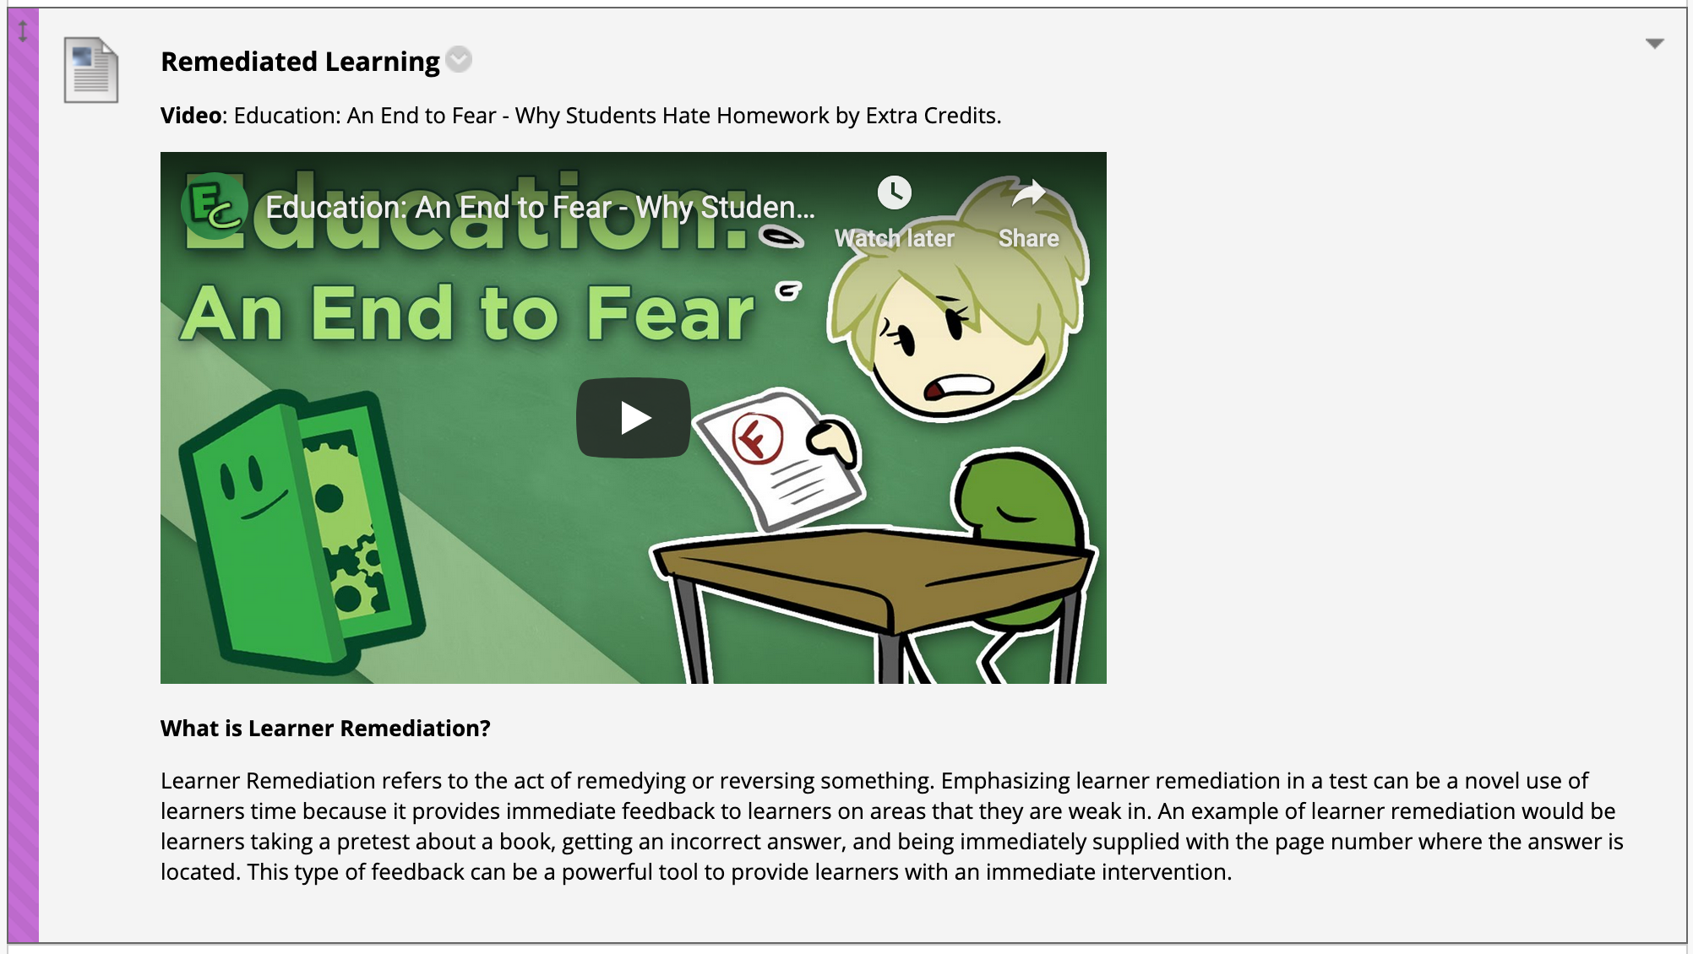
Notes:
Here is an example of what a better designed lecture might be. Please look and then write in chat what you might do differently.

Slide 14
Activities / Assessment

Slide 15
Activities / Assessments
Flexibility
Allow for Alternative Completion
Multiple Modalities
Teach Affectional Objectives
Tone
Use Rubrics
Be Strategic with Important Information
Organization
Authentic Assessment
Outreach
Utilize Formative Evaluation
Utilize Comments
Retention Center
Notes:
So how can you incorporate tone, flexibility, organization, and outreach into your Activities and Assessments?
Tone:
Consider how you organize your activities and assessments. Clean concise instructions help learners process information easier. Repeating due dates and other information has a depressing influence and tends to cause people to “tune out” what they learn is unnecessary. Specifically with due dates, they are often already present because they are identified when an assignment or assessment is created in Blackboard. Then, they are often also listed at the beginning of a module/chapter/week, and in the syllabus. If, for example, people are struggling to get things turned in, making the due date listed ad nauseum, making it bold and underlined, and coloring it in red, is not going to help. There is a different problem at play in such a situation.
Link: No Link.
Rubrics are thought of as something that constricts learners from being creative. However, like most tools, what a Rubric can do is based on how it is written. Providing learners with a rubric gives you the opportunity to tell students specifically what your expectations are, because when you use a rubric it removes the ambiguity of a flat scale from grading. Keep in mind, too, that if you want something like creativity to be an important part of an activity or assignment, and you are using a rubric, you can make creativity one of the columns.
Create a Rubric KB Link: https://kb.siue.edu/53793
Flexibility:
Provide more than one option for the completion of activities and assessments. If you follow the same pattern with course content, activities, and assessment, consider allowing learners to vote on how they complete an activity to break up the same-old-same old. Or, consider if learners could conduct an interview or record themselves having a discussion explaining a topic to someone who is uninformed, or make up a story, or draw a picture, or use Turnitin’s PeerMark feature to allow for peer review. Etc., in order to satisfactorily display if they have mastered whatever they may be learning.
Create a PeerMark Assignment KB Link: https://kb.siue.edu/63214
Organization:
Loosely defined, Authentic Assessment means, “the measurement of accomplishments that are significant, meaningful, and worthwhile”. You may not have heard about this term before, but it an extremely important concept that plays a major role affecting learner satisfaction. Learners in your courses want Authentic Assessment because if they are being authentically assessed, they are being put in a position where they are actively employing what they have learned as it relates to the objectives that you have identified. For example if you are an English teacher teaching the essential elements of science fiction, have learners pick a story and then identify the essential elements of that story. Or, have them create their own story and then detail science fiction elements that were implemented.
Link: No Link.
Outreach:
Blackboard has a tool that learners can use to communicate with you when they complete assignments, and a tool that you can use to assess how learners are doing in your course. First, when learners complete an assignment, they have the option via a specific designated text box called “Comments” to communicate with whomever is doing grading. This feature is underutilized. You could, for example, train users to use this feature and have them give feedback with their assignments, asking them to share with you if they struggled with something. Second, in Blackboard’s course management menu there is a feature called ”Retention Center”.
The Retention Center provides you an opportunity to recognize "at risk" students. The main table displays:
Missed Deadlines - Alert is based on a defined due date for an assignment, test, or survey. Students who do not complete an assignment, test, or survey by the due date trigger an alert based on the option you choose.
Grades - Alert is based on a defined score for any grade or calculated column in the Grade Center. Students who score above or below the defined threshold for a specific grade item trigger an alert. For example, the Retention Center can display total grades columns that grades below 69% to identify students that are at risk of failing.
Course Activity - Alert is based on students' overall activity within your course. Students who are below a defined level of activity trigger the alert.
Course Access - Alert is based on the date users last accessed your course. Students who have not logged in for a defined number of days trigger an alert.
The Retention Center allows you to directly email students at risk as well as keep track of students throughout the semester.
About the Retention Center KB Link: https://kb.siue.edu/62056

Slide 16
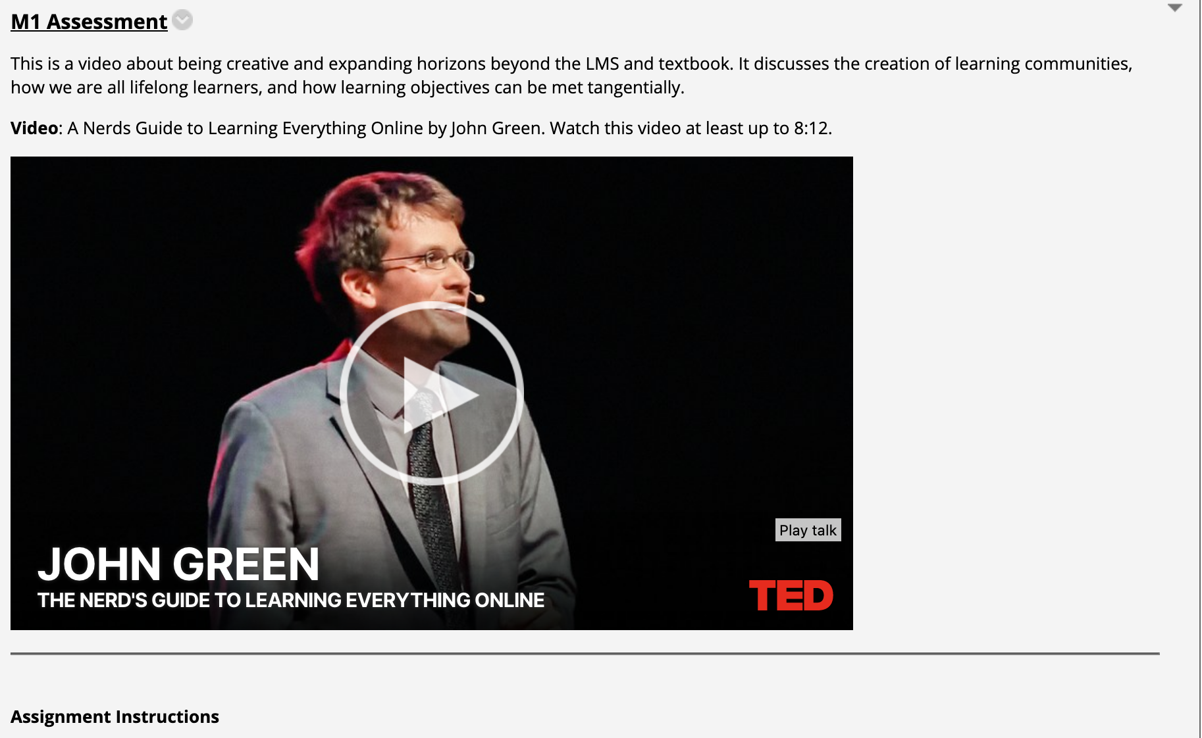
Notes:
Here is an example of what a better designed Assessment might be. Please look and then write in chat what you might do differently.

Slide 17
Discussion Boards

Slide 18
Discussion Board
Flexibility
Encourage Debates
Tone
Discourse Analysis
Organization
Model Responses
Outreach
Muddiest Point
Notes:
So how can you incorporate Tone, Flexibility, Organization, and Outreach into your Discussion Board?
Tone:
Be mindful of how you are contributing to the discussion on a discussion board. There is a method of study called Discourse Analysis that attempts to understand the effects of language and it is often applied to discussion boards for study. This research suggests that there is a happy medium between being omnipresent in all discussions, and absent from the discussion. To break this idea down further, when you are interacting with learners online try to keep in mind that you are there as a facilitator, who’s interactions can sometimes be be the most impactful with a light touch to direct learners, and that you do not need to respond to every post each student makes.
Link: No link.
Flexibility:
There is an often-used formula for discussion board work where learners are asked to create a thread about some specific prompt and then reply to two different classmates' threads. This is not a well-designed discussion board activity, rather it’s an assignment submitted by another means, that’s then placed into what is effectively an echo chamber. Instead, consider using the discussion board to host debates, and putting learners in a position where they must research a prompt to then attack or defend it. This is an example of a well-designed discussion board activity, because it is an authentic assessment of a discussion based objective.
Link: No Link.
Organization:
I know that I always feel more confident about what I need to do for a course after I have taken a Quiz or Exam. I expect you may feel the same. With that in mind, it may be an efficient choice to model the writing that you want from learners by providing them with an actual example, or examples, of what you want them to do. Unless they have taken a course that you have taught before, learners do not know what your expectations are, and offering a written example provides learners with another opportunity to learn how to do something correctly before they are placed in a high stakes grading situation.
Link: No Link.
Outreach:
Having the ability to communicate with peers is an essential component of all online courses. This is repeated over and over in “Best Practices”, and I cannot emphasize enough how true this is. Even if your course does not utilize discussion boards for activities/assessment, learners should always have access to each other. Consider adding what is often referred to as a “muddiest point” forum. A muddiest point forum is a place where learners can go to ask questions. One way to add a muddiest point forum to your class is to make the overview for a week/chapter/unit into a discussion board tool link that links to the same muddiest point forum each time. If you do not want to check this forum regularly, because learners in your course choose not to use it, then you may want to take the additional step of “subscribing” to the forum. This way if someone posts in the forum you will automatically receive an email about it.
How to Subscribe to a Forum KB Link: https://kb.siue.edu/63739

Slide 19
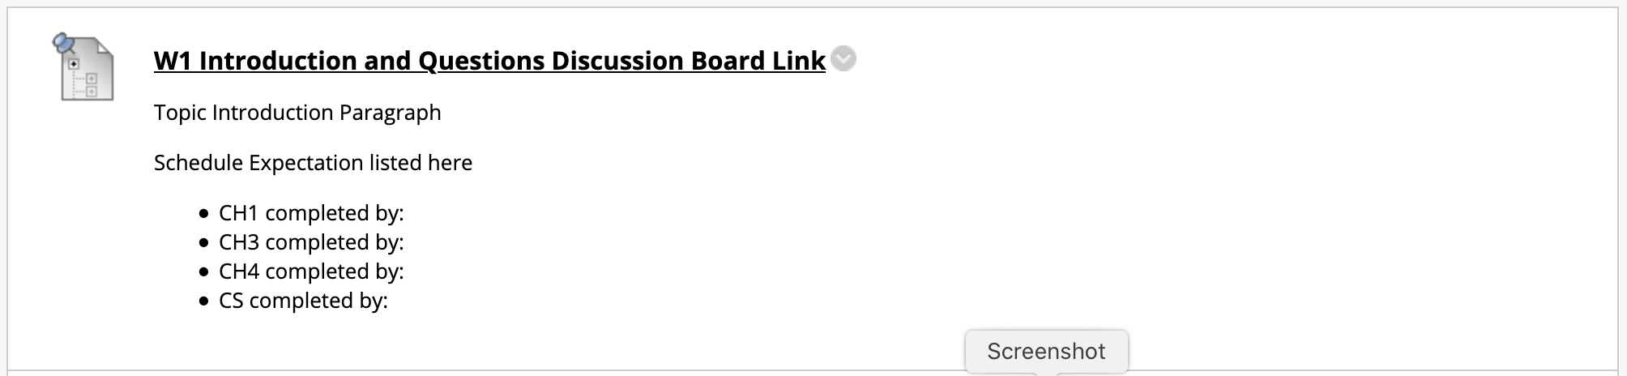
Notes:
Here is an example of what a better designed Discussion Board link might be. Please look and then write in chat what you might do differently.

Slide 20
Summary
Tone
Flexibility
Organization
Outreach
Notes:
When you think about Instructor Presence and Promoting Engagement, I want you to remember these four pillars
Tone
Flexibility
Organization
Outreach
Each is important and should help you make decisions about your course.
No course is perfect. There are always things that can be changed, there is always tinkering that could be done. As you learn more about teaching online, I challenge you to apply these four pillars to your courses.

Slide 21
Resources
Instructional Design & Learning Technologies: http://www.siue.edu/its/idlt/
IDLT Teaching Toolkit: http://www.siue.edu/its/idlt/toolkit.shtml
ITS Knowledge Base: https://kb.siue.edu/
Virtual Training: https://bb.siue.edu/
Notes:
Lastly, for questions on any of the things covered today, please reach out to our IDLT team.
As always, our ITS knowledge base is a wealth of information on how to do things.
And our virtual training is also a great resource if you need more video-based training.

Slide 22
Questions?
Notes:
If you have time, please stick around for questions, otherwise, thank you for joining us. Remember if you’d like to come on the microphone and ask your question live, please use the raise hand button. Remember to keep questions on topic.

