Slide 1

How is Online Teaching Different?
Melissa Thomeczek – Faculty Fellow
Matt Schmitz – Associate Director of Online and Blended Education
Wayne Nelson – Faculty Fellow
ITS – Instructional Design & Learning Technologies
Notes:
Hello and thank you for joining us today. My name is Matthew Schmitz and I’m part of the ITS Instructional Design & Learning Technologies group.
Today is the first webinar of the weeklong series Faculty Summer Camp for Moving Online. Each day a 30 minute webinar will be offered providing an overview of a topic related to online teaching and learning. In addition to these daily webinars, which will be recorded for access later, on-demand virtual training sessions that complement each session topic will also be available.
Topics this week will include planning and organizing your online course, instructor presence, and designing for accessibility. While there will be one webinar per day, all on-demand virtual training sessions are all available now; I’ll show you at the end where those are located. Learn along with us synchronously or learn independently and asynchronously, whatever fits your learning style or availability.
Today we start the series by looking at how online teaching is different from traditional, in-class, face-to-face instruction. We’re going to examine a few of the elements that make an online course different and discuss some strategies for how to interact with students, provide engaging assignments and assessments, and help students succeed in the online environment.
My co-presenter today is Dr. Melissa Thomeczek, faculty in the School of Education, Health, and Human Behavior, and faculty fellow with IDLT. Dr. Thomeczek has taught online extensively, including in a fully-online program, so her experience with creating curriculum and interacting with online students has been incredibly valuable in helping some SIUE faculty make the move to online.
Speaking of that, the sudden move to fully online in March meant a lot of faculty and students were forced quickly to move online, often in courses that were not prepared to make that shift. Ideally the recommendations and examples in this and other webinars and accompanying resources will help with creating quality online courses that lead to student success.

Slide 2
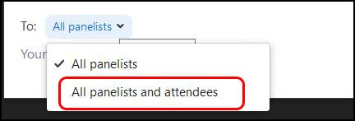
Notes:
To get started, let’s go over the features of the webinar. First, there’s the chat. When using the chat, be sure your messages are going to the intended recipients. The default is to all panelists. Change the drop-down so that it goes to all panelists and attendees if you want everyone to see it. Let’s practice that now. Say hello to everyone. Remember to say it to all panelists and attendees.
Pause Okay, thanks for practicing that. Laura will be helping us out today and monitoring the chat.
The next feature is the Q&A. Please use this feature to ask questions. This can be answered more formally anytime throughout the presentation as questions can easily get lost in the chat. We have Angie helping out with the Q&A today.
The final feature is the raise hand feature. At the end the webinar we’ll take questions from the audience. Use the raise hand feature so we can turn on your audio to ask the question live.
Okay let’s get started.

Slide 3
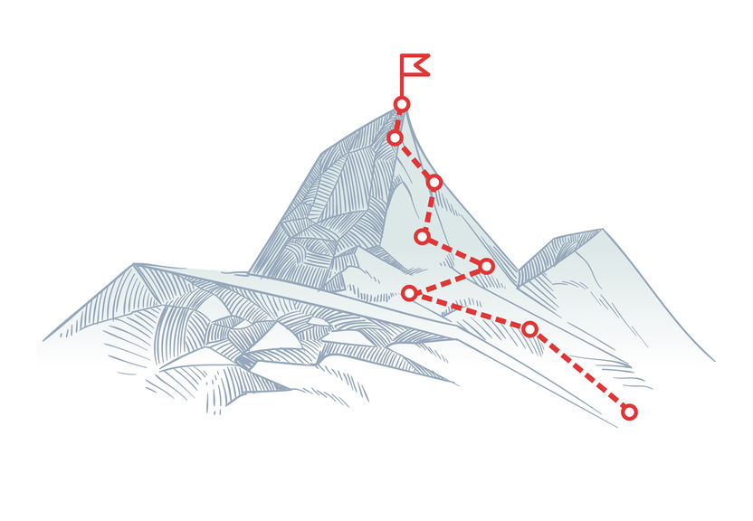
A Common Misconception
Assuming what works in a face to face (F2F) classroom will also work online.
  Understanding the advantages and challenges in online teaching can lead to success – for you and your students.
Notes:
The topic is How Is Online Teaching Different? The simple answer is that online teaching both “is and isn’t” different from traditional teaching but it’s important to realize that those are two parts of the same answer.
For example, can you replicate a learning activity from your F2F course in the online environment? You certainly can. However, while it is possible to transform a F2F learning activity into an online learning activity, the final product may be a bit different online as compared to F2F.
One common misconception is that everything online will -- or should -- look, feel, and operate exactly the same as in the F2F environment. It’s important to realize that this is not always the case. You have to keep the environment – online or F2F – in mind and harness its advantages while creating (or modifying) learning activities.

Slide 4
Advantages of Each Environment
Online | Face to Face
Convenience and flexibility | “Security” of a longer-standing format
The individual is the focus | More “real” face-to-face interaction
Global reach: anytime, anyplace conversations | Traditional College experience: on-campus clubs and extracurricular activities
Teaches self-motivation and self-discipline | Hands-on training for some professions (Nursing or Teaching)
Notes:
There are definitely advantages of both the online and traditional, F2F learning environments.
Proponents have said that online is preferable to some people because of it’s flexibility; online courses are rarely conducted on a live, synchronous schedule, allowing students to engage with the course and content at their own pace and schedule while still completing assignments and assessments with due dates and times determined by the faculty member. Online learning can hypothetically happen anywhere, at any time, and is not constricted to a brick-and-mortar classroom. Because of the individualized nature of online learning, students in online courses need to have skills to manage their time and projects and the discipline and motivation to complete their coursework.
There are also advantages of traditional, F2F courses. In addition to both faculty and students understanding their respective roles in the F2F classroom because of prior experience, many faculty and students contend that they get more “real” and “honest” interactions and discussion in F2F courses than is possible in online discussion boards. The hands-on training for many professions, including clinical experience for nurses and classroom experience for teachers, is also another advantage of F2F coursework.
This being said, some people see some of these benefits as detriments, too. For example, the global reach/anytime, anyplace concept of online courses is beneficial but, without parameters, students often think that faculty are or should be available 24/7/365 to answer any question or resolve any issue. Similarly, on the F2F side, sometimes situations negate the possibility of a F2F experience; for example, during the spring semester, COVID-19 also shut down K-12 schools, ending the placements for student teachers. How will these types of hands-on training or clinical experiences look in the near future? Will they continue to be F2F?

Slide 5

Physical attendance is easy to see
Online presence is easy to fake
Real Student Engagement is the Goal
Notes:
Another way that online learning differs from F2F learning is expectations. Students in face-to-face courses, for the most part, “know the drill” because they’ve been taught the expected classroom behavior throughout K-12. They know the expected ways to interact with the instructor, the other students, and what types of actions or behaviors are expected or forbidden in the classroom.
However, online education doesn’t have the same foundation; students likely haven’t been taking part in online classes for very long (or at all). Because of this, it’s important for faculty to acknowledge that there is a need for some community building in the online environment. This includes setting expectations for the students and creating opportunities for student interaction and engagement, making them active participants in the teaching and learning processes.
A student in a F2F class can be physically present and there are keys (body language, lack of participation, etc.) that indicate whether the student is engaged or not. “Seeing” these same things in an online course is often not as easy. Because of this, another key difference between online and F2F is that, in online, student engagement must be a primary goal, one that will help students be active rather than passive learners. There are many ways that online is different from traditional learning but engagement is a key difference, one we’ll be exploring in more detail.

Slide 6

Don’t Let Students Get Lost
“Getting Started” guide
Scaffold assignments early
Provide specific and detailed instructions
Notes:
Some of the ways to increase student engagement are to let the students know what is expected of them and what they need to do to be successful in the course.
The first day of many F2F courses starts with introductions (instructor and class), a review of the syllabus, and a discussion of the course structure, assignments, and assessments. The same can be accomplished in the online course but, like other activities, will need to take a slightly different form. Providing the students a “getting started” guide will inform the students how you will be providing information, where they should start in the online course (syllabus), how to find learning activities, where to submit assignments, how they will receive feedback, etc. Many faculty elect to have a course overview and also a weekly introduction to also cover topics on a smaller scale.
It’s also advisable to allow the students to learn the system so their focus can rightfully be on the content when it comes time to complete an assignment or assessment. Scaffolding preparatory assignments help students interact with Blackboard and get to know how you have set up the course. Consider creating a syllabus scavenger hunt, a quiz (for bonus points only) about the instructor, submit a picture of themselves as an assignment, or introduce themselves to their classmates by creating a discussion board post. Use the tools you will use during the class by having students create, engage in, and submit activities and assignments.
Another key is communication, including being clear and specific about what you expect from an assignment or activity. By using a rubric or just text, let the students know what is – and isn’t – expected of them and their work. In a F2F course, a two- or three-minute discussion can provide a lot of details to help clarify assignment expectations and eliminate student confusion. Be sure to provide that same clarity for online students. (Also, just know that, when you don’t provide detailed instructions, you will likely be flooded with email questions.)

Slide 7

Online Learners May “Disappear”
Online students don’t feel the same pressure to remain digitally present. Students might:
  Lurk: remain hidden, but continue to watch/listen
  Ghost: cease all communication
To prevent digital absence:
  Offer synchronous Q&A sessions
  Reach out to individual students
Notes:
In a F2F classroom, students who are confused or feel uncomfortable tend to “wait it out” until they feel confident enough to ask a question, either during or after class. After all, they are sitting in front of you and walking away would be obvious. And rude. Social norms dictate that they should stay seated. In an online classroom, the same social rules don’t apply. Students can walk away from the computer or course at anytime if they are not engaged with the instructor, content, or their peers.
But there are ways to deal with students who have become lurkers or, worse, ghosts.
Students who have “disappeared” digitally have likely distanced themselves from the class emotionally. Students may feel they are the only ones who don’t understand the material or have questions about assignments. By offering a Q&A session, students can have their questions answered. Even if a digitally absent student doesn’t ask a question, he/she will hear other students asking questions and realize they are not the only person who doesn’t understand. Participating in a session like this also allows the students to engage and interact with their instructor and classmates, which goes a long way to community building.
Sending an email to a digitally absent student has two benefits: 1) The student knows that you have recognized their absence. Sometimes students who get overwhelmed in an online course feel that if they disappear, the instructor may not notice. By emailing them, you are letting them know, “Yes, I have noticed your absence.” It will increase their motivation to start participating again. 2) If you word your email kindly, the student will feel that you care about them personally, as a learner. Students like personal connection with the instructor.
I'm going to turn things over to Melissa to discuss different types of interactions.

Slide 8

Online Learners Need
Personal Interaction
  With the instructor
  With peers
More communication, not less
Notes:
MT SLIDE
In an online classroom, learners need personal interaction with you, their instructor, and with their peers. While this is not different than the F2F classroom, it is something that is less natural.
In a F2F classroom, typical social interactions occur. Informal talking before class starts, smiling or acknowledging each student as they walk through the door, or even noticing a new hair cut are small interactions that happen in a F2F classroom. Students might talk about an upcoming event or discuss a T.V. show they have been watching.
In an online classroom, these type of interactions are less likely to occur spontaneously. Students and instructors both tend to “get down to business” when they are on synchronous sessions and, in the asynchronous environment, it’s not possible to greet each student as they enter the classroom or notice if they have a new hair cut.
In order to have these personal interactions, it is necessary to plan ahead.

Slide 9
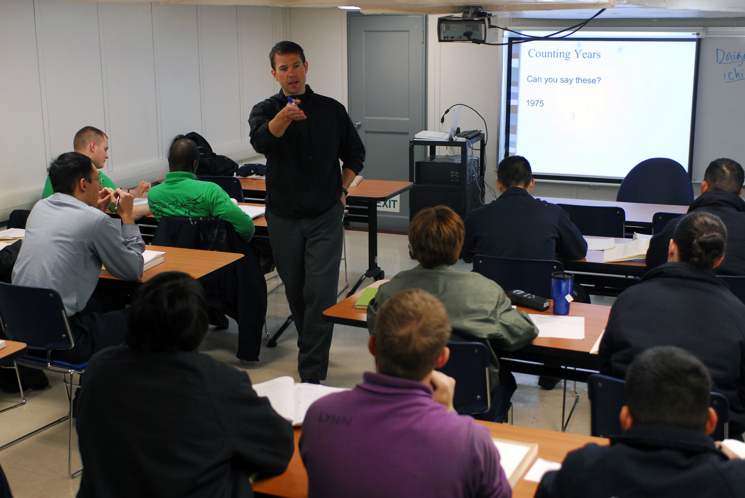
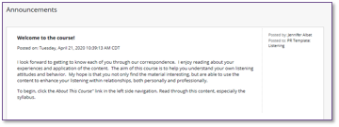
Instructor Interaction
Tell students about yourself
Create a “Welcome” for students
Notes:
MT SLIDE
Students want to know about you, not just that you are their instructor. They want to know you as a person. Do you have kids? Are you a dog person? Have you served in the military? Do you have any special skills or unusual experiences? Learners like to hear stories about your past. It makes their experience with you more personal. It increases the likelihood that they will reach out to you when they feel confused about the course content or an upcoming assignment. Consider creating an Introduction discussion forum. Post a message telling the students a few things about yourself and then ask the students to do the same.
Simultaneously, you could create a Welcome video/audio/or a Blackboard item that discusses the course content. This would introduce students to the course and let them know what they will be learning during the semester.

Slide 10

Peer Interaction
Offer an optional synchronous Zoom session to “Get to Know Your Peers”
Require participation in an asynchronous introduction activity, like a Discussion Board
Notes:
MT SLIDE
In addition to getting to know the instructor, learners need to connect to their peers as well.
Synchronous sessions are great for letting students get to know each other. If you have a Zoom session, make sure to record it so that students who are unable to attend live, can watch the recording later. By getting to know their peers, students feel a connection to the course. They aren’t “going it alone”. It also helps them feel more comfortable asking each other questions when they arise later in the course.
Asynchronous sessions could be informal, like the welcome discussion, or they could be related to course content. Discussing a research article or a chapter in the text can also help students form personal connections with their peers and with the course content.
When students are engaged with one another and the instructor, two things happen: First, they report greater satisfaction with the course and secondly, their perception of what they have learned in the course increases.
While interaction is important throughout the course, remember it key to start the interaction immediately when the course begins.

Slide 11
More Communication
Prepare receive more email
“Questions & Concerns” discussion forum
Encourage peer interaction
Be present
Notes:
MT SLIDE
Online students aren’t afforded the opportunity to see/hear all the interactions between the instructor and all students.
Therefore:
You can limit this to some extent by using the strategies below, but you will still have more email from online students than you do in a F2F course.
In your course introduction, tell students about the Q&A forum. Tell them to check that forum first to see if the question has already been asked and answered before emailing you.
This is where the early engagement with peers pays off. Students will feel more comfortable asking questions of each other if they have already had interactions early in the course.
When you have discussions in the course, consider keeping track of students you respond to during discussions. Make sure that you are responding to or engaging with each student at least every other week.

Slide 12

Online Learners Need
Notes:
MT SLIDE
Just like F2F learners, online learners need feedback. However, in an online course, it is difficult for students to anticipate when they will receive feedback and when they won’t. Additionally, the timing of feedback can be an unknown.
As the instructor, it’s important for you to let students know:
When students will receive individualized feedback. There are times when individualized feedback isn’t necessary. For example, if you ask students to post a discussion message and respond to 3 peers, your expectation might be simply that they engage 4 times total. That may not need the individualized feedback that you would provide on a more detailed assignment, like a research paper.
How they will receive feedback. Will you email them? Use the Assignment tool in Blackboard? Telling students where to look for their feedback will reduce email inquiries.
Timeliness of feedback. If you have a large assignment that will take significant time to grade, you should be up front with students about this. Telling them it will take you 2 weeks to give feedback to everyone helps manage their expectations and decrease your email inbox with questions.

Slide 13
Feedback Benefits Students & Instructors
Students want to know if they are understanding the concepts and performing well.
Instructors want to know if their teaching methods are working.
Ask confirming questions and review more often
Notes:
MT SLIDE
Students want to know if they are understanding the concepts and performing well.
Instructors want to know if their teaching methods are working.
By asking confirming questions of students and reviewing content more often, you will recognize when students are understanding content. Additionally, students will tell you if they understand concepts or how well an assignment was created.

Slide 14

Tell students when they are doing well
  Positive praise encourages online interaction.
  Redirection often leads to improved involvement.
Notes:
MT SLIDE
(& when they are not)

Slide 15
Manage Expectations
Have a clear communication policy
Email within 24 hours.
Assignment feedback within 1 week
Not all assignments need personalized feedback
Notes:
A few slides ago we mentioned that one of the differences between F2F and online is expectations, the fact that students have been conditioned how a F2F course works but that the same is not true for online. Managing expectations – for students and for yourself – is a big way to ensuring success for the students, you, and the course overall.
Online education *can* feel like you are never off the clock. You and your students are likely active at different hours and there is often an expectation of a rapid response to a question or problem. However, be clear with your students from the start of the course how communication will be handled. Do you prefer that students send you an email or would you prefer a chat message in Teams? Is there certain information that should be included in each message? Will you be providing a weekly announcement to preview the upcoming week or review the previous week? Will you be available electronically until a certain time each day? Will you have a standardized length of time for replying to emails or providing assignment feedback? How does the weekend factor into all of this? Letting students know all of that helps them understand how you will communicate with them and how they should communicate with you.

Slide 16
Typical Online Students:
Current Online Students:
Drive instruction
Want to be led by the instructor
Are highly self-motivated
Desire the online environment or need the flexibility it offers
Universities are offering online consistently.
Students are being pushed online, rather than choosing it.
So how can you encourage your students who didn’t choose this environment?
Notes:
Ideally, all online students and faculty would be in the environment by choice, but that is not our current reality because of the pandemic.
Normally students who choose online do so willingly because they like the flexibility and have the kind of drive and determination to be a successful online student. However, many universities -- SIUE included – are offering more courses and programs in a fully online format. Some students, including non-traditional students returning to education after many years away from school, might not be comfortable with an online-only option given their familiarity with traditional, F2F courses. We also have the reality of our current situation, where the large majority of learning is taking place online and many of the students did not actively choose this delivery mode. While the current situation is not ideal, it does create many opportunities for creative problem-solving and course delivery, opportunities to show students the benefit of an online education.
So how can you encourage students who didn’t chose or might not be initially comfortable with online teaching and learning? Encourage interaction and engagement to create more student-driven assignments and activities in your online course. Make students be active participants in the course. And in and their learning. Melissa is going to talk more about how to accomplish this.

Slide 17

Encourage a Student-Driven Course
  Listen to their needs
  Give them assignment choices
  Use communication tools to help them learn from each other
  Be a strong facilitator
Notes:
MT SLIDE
Students prefer to have a say in what they are learning and how they are learning. If you can provide them with options, their course satisfaction and their autonomy with the content increases. If they prefer to listen to research articles, rather than read them, consider providing a recording of the article being read and allow students to choose.
When possible, allow students options to show their learning. It’s possible that a 5 page paper could also be a 5 minute video…or a multimedia presentation. Consider alternative ways that students can show you their learning and let them choose the assignment type that they prefer.
This could be discussion forums, peer reviews, or even video conferencing. Use communication tools to facilitate students’ engagement in the content with one another. You are not the only source of information in the course.
Facilitating means that you are not the “be all, end all.” Encourage students to problem solve together. In a discussion forum, you could say, “Juan brings up a good point. Everyone else, would the textbook support this?” You don’t have to jump in and give the “right” answer. Allow your students to come to an understanding of the content. Facilitate. Guide them. Learning is more meaningful when they come to it through their own discovery.

Slide 18
Create Manageable Work Loads
Break assignments & activities into smaller pieces.
Consider things that can be
finished in 20 minutes or less.
Acknowledge distractions in the home or competing obligations.
Notes:
MT SLIDE
Breaking a Larger Assignment Down:
Research Paper Example:
Create an outline
Write an introduction
Identify 3 key points
Find research support for 1 point
Students can always do more than one piece, if they have the time and focus, but providing 20 minute activities/assignments will allow all students to move through the material in a way that is most effective for them.

Slide 19
Be aware of limitations
Some things never change
Building Quality Online Courses
Notes:
How Is Online Different? Another important way is course design. Many people will tell you that designing an online course is more work and takes more preparation than developing a F2F course. This is true; building a quality, online course takes time and planning. No denying that. Even a “spontaneous” activity in an online course (an unplanned discussion board about a current topic or event) takes planning and clear communication to the students to make sure it’s successful.
IDLT is available to assist with developing courses but faculty should be aware that their own time and abilities might also limit what can realistically be accomplished in designing an online course. Are you teaching the course next year or next month? Will you or the students be using a new or unfamiliar piece of software? All of these are important questions to think about when designing an online course.
Also, converting a course from F2F to online doesn’t mean that every activity, assignment, or assessment needs to be reimagined or reworked. If there is something that you’ve been doing or using in your F2F course and it can transfer easily online, then move it as-is. If an activity is successful in helping students learn the content and achieve the course goals, then that’s the ultimate goal.

Slide 20

Realistic Expectations
Transferring a course to online takes time.
Don’t expect perfection with your first attempt.
Create the best quality possible with the time available.
Plan to revise.
Notes:
Faculty should try to have realistic expectations when building an online course.
It’s a long process with many aspects and nuances to consider.
Give yourself permission to not get everything right the first time. A course doesn’t need to be perfect the first time it’s offered.
Design, build, and modify knowing that you will always find something you want to revise or improve upon. Engaging with the students will let you know what needs to be amended or removed and where are the potential pain points in the course.
Try to revise one document/learning activity/discussion forum. Consider: How did it go? How could you make it better? What did the students do well? What were some challenges? Again, engage with the students to find out what does and doesn’t work.
The unwritten fifth expectation is to realize that you’re not alone. In addition to IDLT, there are dozens of your faculty peers who have built and delivered quality online courses. Don’t hesitate to ask for help if you have a question or run into an issue.

Slide 21

Universal Truths in Course Design
Expectations must be clear.
Communication must be clear.
Quality interaction is necessary for a
successful course.
Design is important.
How students engage with the
content is most important.
Notes:
MT SLIDE
These are true regardless of the environment
How students engage with the content is more important than the content itself.
You can have the greatest content ever, but if students don’t engage with the content, then they won’t learn.
Modified from: https://miamioh.edu/regionals/academics/elearning/ecampus-faculty-staff/eccoe-news/2019/01/differences-between-f2f-and-online.html

Slide 22

Maintain a Student-Centered Approach
Self-motivated students will do well.
Motivating student interest is more
important than instructor knowledge.
Quality teaching considers the individual student, not simply the class.
Showing students you care about them makes all the difference.
Notes:
MT SLIDE
Modified from: https://miamioh.edu/regionals/academics/elearning/ecampus-faculty-staff/eccoe-news/2019/01/differences-between-f2f-and-online.html

Slide 23
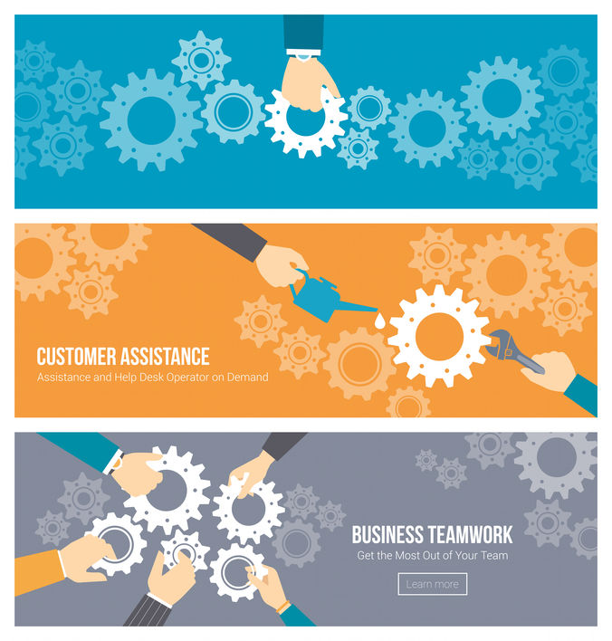
Technical Issues
If you teach online, you will likely experience a technical issue sooner or later.
Remember that ITS is always here to help you and your students.
  Help Desk: 618-650-5500
  Both students and faculty can report technological issues to the Help Desk.
If it is a course design question, your call will be referred to IDLT and an Instructional Designer will contact you.
Notes:
(I want to ask Jeff some questions about the script for this page. But I can likely do this in my sleep.)

Slide 24
Resources
Instructional Design & Learning Technologies: http://www.siue.edu/its/idlt/
IDLT Teaching Toolkit: http://www.siue.edu/its/idlt/toolkit.shtml
ITS Knowledge Base: https://kb.siue.edu/
Virtual Training: https://bb.siue.edu/
Teaching & Learning Continuity: https://www.siue.edu/its/idlt/teaching-learning-continuity/
Miami University Article (13 Differences Between Online and F2F Courses): https://miamioh.edu/regionals/academics/elearning/ecampus-faculty-staff/eccoe-news/2019/01/differences-between-f2f-and-online.html
Notes:
Need to mention here that the Programs section of the IDLT site is where to access the on-demand Rise courses.

Slide 25
QUESTIONS?​
Notes:
That brings us to the end of our first webinar. As I hope we’ve illustrated, there are many differences between online and F2F learning, including some we didn’t touch on during the presentation. However, student engagement is critical in the online environment. Providing opportunities for your students to engage with you, the content, and their classmates will go a long way to helping them succeed online. Additional webinars will dig into other elements of building and offering a course but, for now, we can answer questions if any one has any or would like us to follow up on any point that was made.

