Slide 1
Notes:
I also made you a promise – namely that in the fall semester, we would get into more details about the Program, about advising, how things start fitting into your major plans, and all of that. I’m going to START fulfilling that promise today – although I must warn you, you will still here me defer some questions and planning until the future. Advising – like learning – is an on-going process. We won’t conclude until 4 years from now.
But before we start planning ahead, let’s do a reflection first. Using your phone …

Slide 2


Slide 3

BUILDING
BRIDGES
BEYOND

Slide 4

BUILDING

Slide 5
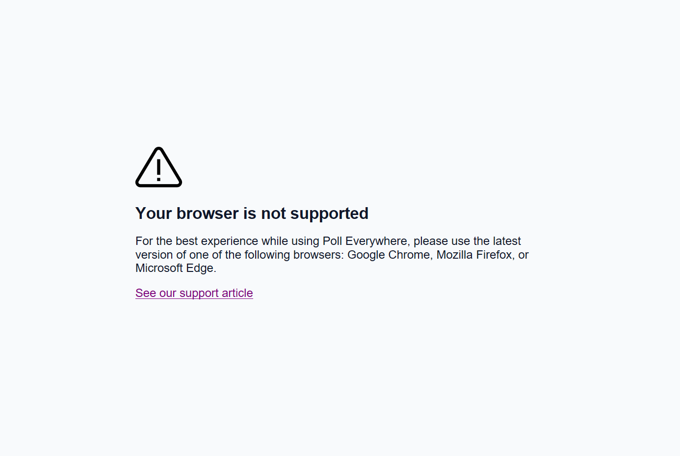
Notes:
Poll Title: Which of these best describes the reason you chose to attend college?
https://www.polleverywhere.com/multiple_choice_polls/wufUUMik8fZeEQ0

Slide 6
REASONS TO ATTEND COLLEGE
84%
To be able to get a better job
83%
To learn more about things that interest me
79%
To get training for a specific career
75%
To get a broad appreciation of ideas
73%
To be able to make more money
60%
To prepare for grad/professional school
50%
To make me a more cultured person
37%
To please my family
Notes:
So here are the percentages for the 2019 entering class. What do you notice? What are your thoughts on this?
Interestingly, make more money has been nearly 70% since 2000 and to get a better job has risen from 70% in that same year.
So getting a job and money are important. For sure. No question about it. In fact, when we look at it, those related to those items are specially related to a pragmatic goal.

Slide 7
THE “REAL” REASONS?
84%
To be able to get a better job
83%
To learn more about things that interest me
79%
To get training for a specific career
75%
To get a broad appreciation of ideas
73%
To be able to make more money
60%
To prepare for grad/professional school
50%
To make me a more cultured person
37%
To please my family
Notes:
So here are the percentages for the 2019 entering class. What do you notice? What are your thoughts on this?
Interestingly, make more money has been nearly 70% since 2000 and to get a better job has risen from 70% in that same year.
So getting a job and money are important. For sure. No question about it. In fact, when we look at it, those related to those items are specially related to a pragmatic goal.

Slide 8

IF WE ACCEPT AS TRUE …
Focus on Skills?
Focus on Majors?
Tell You What to Take?
Ignore Co-Curricular Life?
Notes:
Accepting this information at face value, then, why don’t we just have honors students – or all students – simply take a pragmatic, vocational type of education. What is the use of some course like HONS 120, or SOC 111, or for that matter – calculus for pharmacy students?
It’s not that students are entirely focused on the credential. Three-quarters of students say that “to gain a general education and appreciation of ideas” is also very important, but it seems students recognize the deal when it comes to pursuing a postsecondary degree. You’re going to experience stuff and mature along the way, but that’s a by-product of the main focus—improving one’s economic prospects.
Debate Is Not Central to the College Experience
In fact, it hardly matters at all.
John Warner
June 12, 2022

Slide 9












ATTRIBUTES EMPLOYERS
SAY
THEY SEEK
X
X
X
X
X
X
NAT’L ASSN OF COLLEGES & EMPLOYERS (2020)
Problem-Solving
Skills
86
Initiative
73
Analytical &
Quantitative Skills
79
Strong Work Ethic
71
Teamwork Skills
76
Technical Skills
65
Written
Communication Skills
73
Flexibility &
Adaptability
63
X
X
X
X
X
X
Win
Lose
Cheer
Boo
Silence
Notes:
So again – accepting that work/money/career is one of the major driving forces behind why students attend college, let’s explore what employers want you to have from your experiences.
1. Ability to work in a team structure
2. Ability to make decisions
3. Solve problems (tie)
4. Ability to communicate verbally with people inside and outside an organization
5. Ability to plan, organize and prioritize work
6. Ability to obtain and process information
7. Ability to analyze quantitative data
8. Technical knowledge related to the job
Proficiency with computer software programs
Ability to create and/or edit written reports
Ability to sell and influence others
So why don’t we simply focus on your major, to the exclusion of other things ….

Slide 10
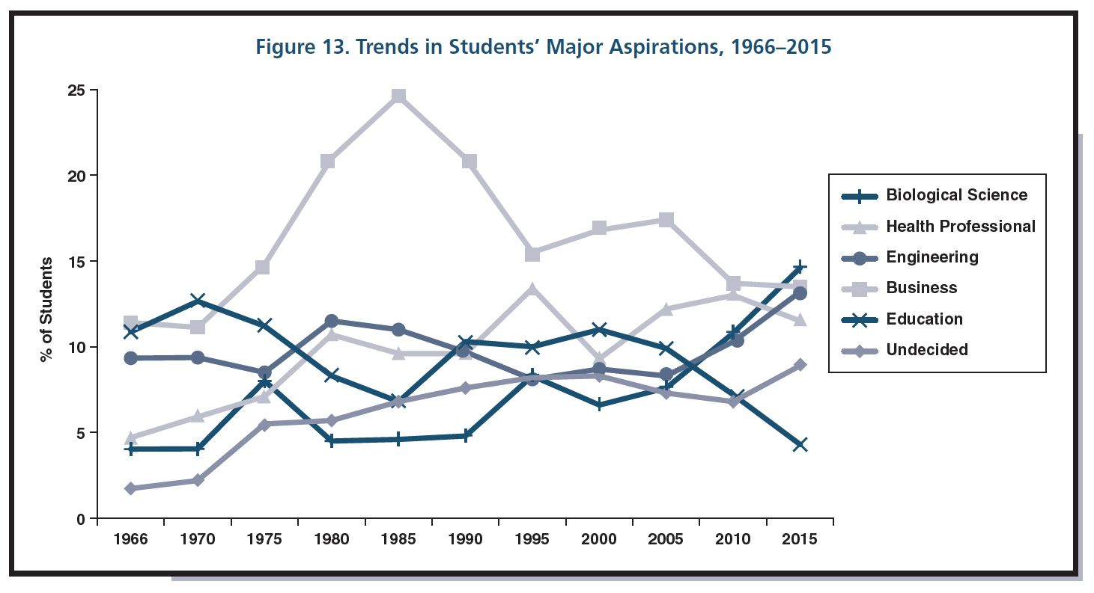
BECAUSE THINGS CHANGE

Slide 11
BECAUSE YOU CHANGE
An estimated 20 to 50 percent of students enter college as “undecided” (Gordon, 1995)

Slide 12
BECAUSE YOU CHANGE
An estimated 75 percent of students change their major at least once before graduation (Gordon, 1995).

Slide 13

BECAUSE YOU CHANGE
… [A]ccording to the National Center for Education Statistics, on average, college students change their major at least three times over the course of their college career.

Slide 14
BECAUSE IF WE BELIEVE
To be able to get a better job
To get training for a specific career
To be able to make more money
To prepare for grad/professional school
Notes:
You have to engage in your education like this ….

Slide 15
IT’S BEST TO EMBRACE
To learn more about things that interest me
To gain a broad appreciation of ideas
To make me a more cultured person
Notes:
You have to engage in your education like this ….

Slide 16

essentials of a “liberal education”

Slide 17
essentials of a “liberating education”

Slide 18
honors
electives
clubs
minor
major
friends
advising
family
activities
professional tests
goals
research

Slide 19
Things You May Not Have Considered
Explore Options & Interests
We help you identify and maximize CONNECTIONS.
Short- & Long-Term Planning
Course Options
Questions (Both Ways!)
Resources &
Referrals

Slide 20
Study Abroad
Internships/Shadowing
Multiple Areas of Study
Research/Creative Activities
Did You Know

Slide 21
We’ll discuss all these in upcoming semesters, starting with our BEYOND session next spring.

Slide 22
Identify Advisor(s) in Starfish Network
Schedule Your Appointment Through Starfish
Pay Attention to Style & Date

Slide 23

Think ahead, but plan for the immediate
Pre-advising work is REQUIRED
Due by 4 pm the day before appts.
Chance to consider things in advance
Be honest (with us and yourself)
The next four ...

Slide 24
Think ahead, but plan for the immediate
Pre-advising work is REQUIRED
Due by 4 pm the day before appts.
Chance to consider things in advance
Be honest (with us and yourself)
The next four ...

Slide 25
Think ahead, but plan for the immediate
Pre-advising work is REQUIRED
Due by 4 pm the day before appts.
Chance to consider things in advance
Be honest (with us and yourself)
The next four ...

Slide 26
Think ahead, but plan for the immediate
Pre-advising work is REQUIRED
Due by 4 pm the day before appts.
Chance to consider things in advance
Be honest (with us and yourself)
The next four ...

Slide 27
Think ahead, but plan for the immediate
Pre-advising work is REQUIRED
Due by 4 pm the day before appts.
Chance to consider things in advance
Be honest (with us and yourself)
The next four ...

Slide 28
Think ahead, but plan for the immediate
Pre-advising work is REQUIRED
Due by 4 pm the day before appts.
Chance to consider things in advance
Be honest (with us and yourself)
The next four ...

