Slide 1
Cougar Cupboard Volunteer Training

Slide 2
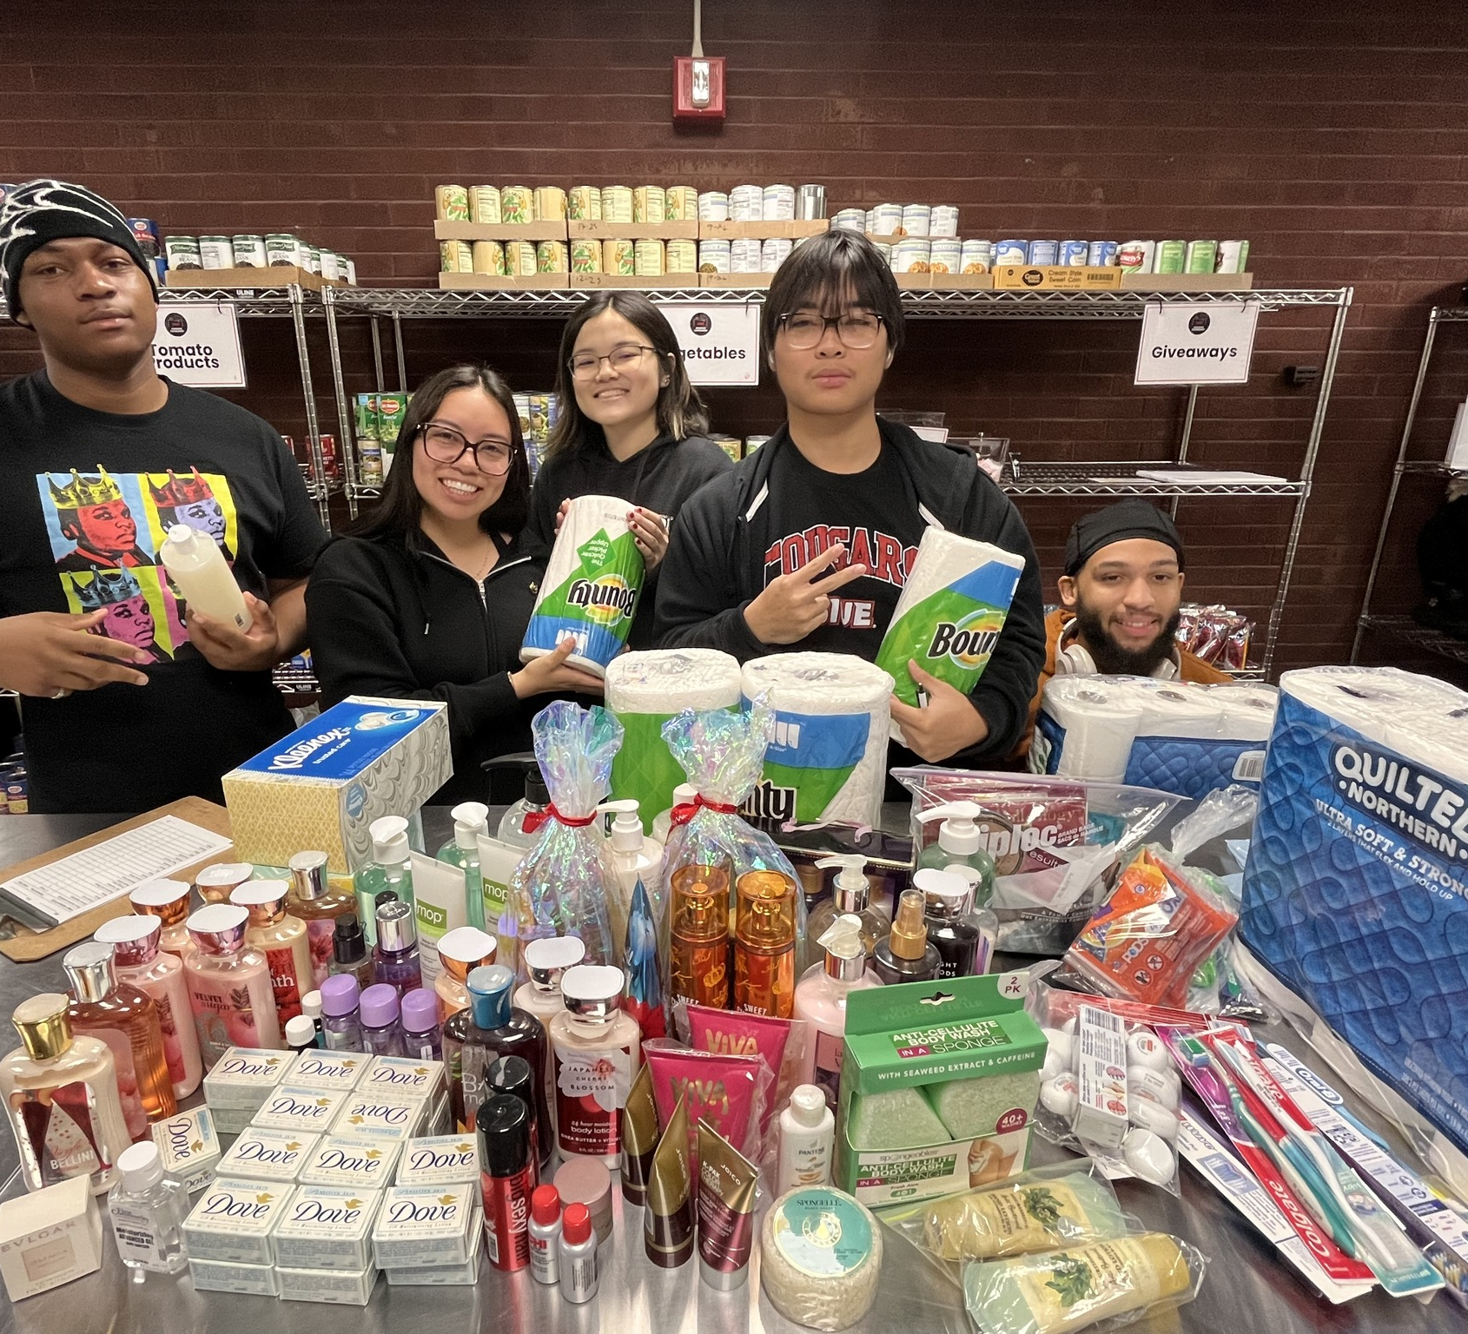
This is the volunteer training for the Cougar Cupboard. Everyone who volunteers in the Cougar Cupboard must take this course prior to their first shift. Upon completion, 15 minutes will be added to your first volunteer shift. Thank you for signing up to volunteer at the Cougar Cupboard!

Slide 3
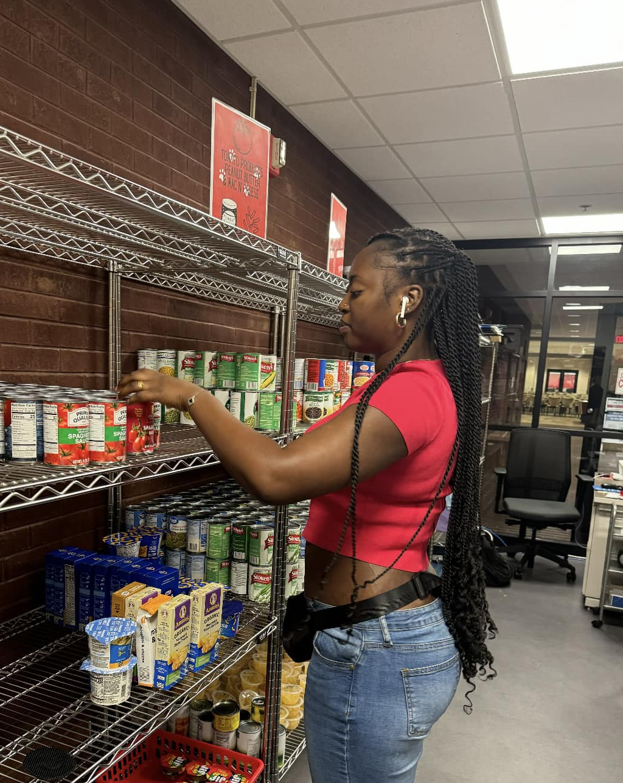
What is the Cougar Cupboard?
The Cougar Cupboard is a non-profit food pantry located at SIUE serving students, faculty, and staff members. The Cougar Cupboard's food and toiletry items are supported entirely through donations and grants.
The Cougar Cupboard is located on the Lower Level of the MUC, room 0012 (around the corner from textbook services)

Slide 4
Volunteer Attendance Policy
All volunteers must be signed up to volunteer on the official Sign-Up genius page or have been authorized by a Cougar Cupboard staff member to volunteer
By signing up to volunteer, you are agreeing to abide by these attendance policies.
We require a 24-hour notice to cancel a volunteer shift without penalty. Shifts with less than 24-hour notice will be considered a no-show. Volunteers are allowed 1 no-show shift. After 2 no-show shifts, volunteers are subject to a semester-long ban from volunteering at the Cougar Cupboard.
To cancel your shift, email cougarcupboard@siue.edu and delete your shift from Sign-Up Genius to cancel
Cancellations with less than 24-hour notice will be reviewed on a case-by-case basis for emergency situations (sickness, car trouble, etc.)
4 no-contact tardies are allowed before a volunteer is banned from volunteering.
15 minutes late or more without prior contact counts as a tardy.

Slide 5
Attendance Agreement Policy
Important: The Community Engagement Team has the right to refuse access to the service experiences it sponsors.*
The previous slide outlines the Community Engagement Attendance Agreement Policy. If a student has violated these policies within either the Spring or Fall semester (both occurrences falling within one semester) the Supervisor reserves the right to block any future attempts by the student to volunteer for Cougar Cupboard shifts, as it will have been determined it is a detriment to the program. When the semester’s restart January 1st and/or August 1st the student may again start to engage in volunteer opportunities in the Cupboard once again.

Slide 6
Volunteer Policies & Expectations
No eating or open drinks are allowed in the Cougar Cupboard. Drinks with a secure cap are allowed to prevent spills.
No headphones or earbuds are allowed while serving clients. Headphones may be allowed while completing independent stocking tasks in the stock room.
Do not invite friends to the Cougar Cupboard unless they are volunteering or shopping.
Treat all clients with respect and dignity. Disrespectful behavior towards clients, other volunteers, or staff will not be tolerated. Disrespectful volunteers will be asked to leave and risk a semester-long volunteer ban at the Cougar Cupboard.
Refrain from derogatory language and cursing.
Do not engage in verbal or physical aggression of any kind.
No alcohol or drugs should ever be brought onto or used on the premises.
Follow the direction of Cougar Cupboard staff members.
Note: If a volunteer comes to their shift smelling of marijuana or alcohol, it can pose a safety concern and be a hygiene issue, especially when working around food. The volunteer will be asked to leave.
As far as the law- SIUE has policy stating no marijuana use on campus so it is at the discretion of the Cougar Cupboard director to not allow one to work if they feel they are under the influence of alcohol or marijuana.

Slide 7
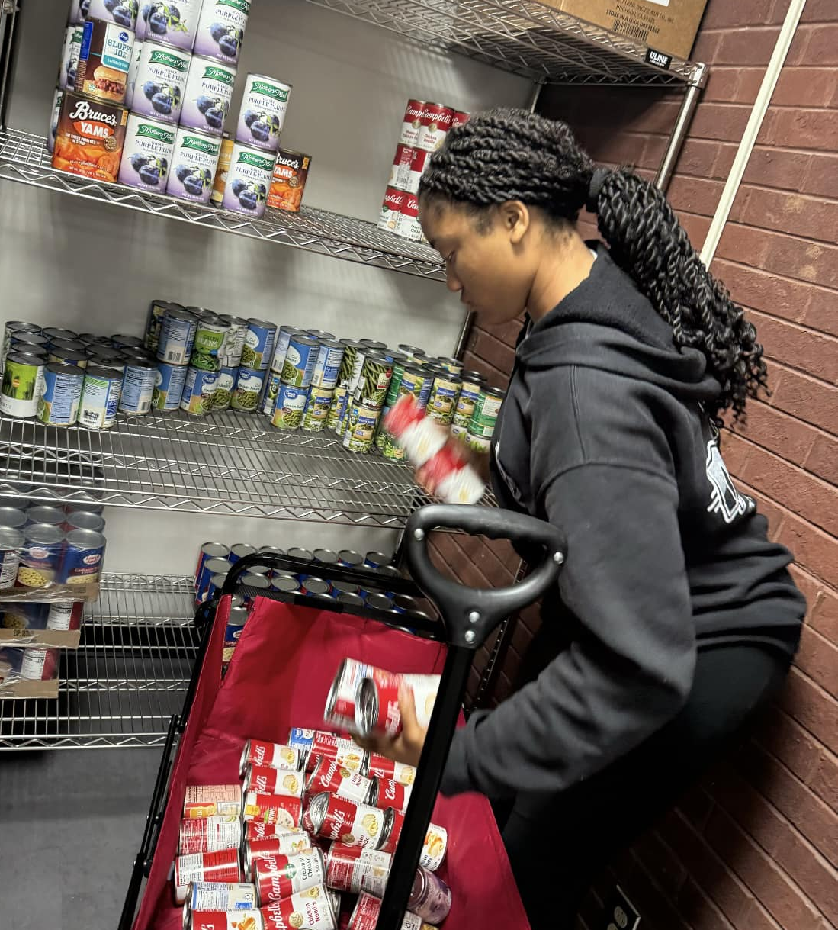
Cougar Cupboard Client Rules
Service is on a first-come-first-serve basis.
Saving spots in line is not allowed.
A maximum of 4 clients are allowed in the Cougar Cupboard at a time.
Disrespectful clients or clients causing safety issues will be asked to leave.
Cougar Cupboard Donation Procedures
We do not accept homemade goods, opened food items, or repackaged food items
Certain expired items may be accepted. Refer to STL Food Bank guide in the Cupboard regarding what expired foods are still safe to eat. Any expired foods considered unsafe should be thrown away immediately.
Volunteers may be asked to assist a donor with loading items using our available wagon.
When intaking a donation, write expiration dates (month and year) on the top of the cans in sharpie. Double-check expiration dates on all items. Any food items close to expiring should be placed towards the front of the shelves.
Donations can then be directly stocked onto shelves or placed in backstock areas. Stock any refrigerated items first and then shelf-stable items. Stock bulk items in the Student-Parent Shopping Area

Slide 8
Health Code Rules and Regulations
The Cougar Cupboard must abide by health code regulations to ensure the safety of our clients.
No homemade food or repackaged food is accepted
Perishable donations should be put away in the refrigerator immediately
Expired food (past safe-to-eat guidelines) should be thrown away immediately
Write the expiration date clearly on top of canned goods. Canned goods approaching expiration should be placed towards the front of the shelves (FIFO)
All food items must be placed with a 4-inch gap between the food and the wall
No food items should be stored on the floor
Non-food safe items (i.e dish soap, laundry detergent, deodorant) should NOT be stored near or above food items
Replace sticky traps regularly
Sweep up any dry spills immediately. If any wet spills occur, alert the MUC Help Desk for janitorial assistance.

Slide 9
Volunteer Duties: Checking Out Clients
Your number 1 priority while volunteering at the Cougar Cupboard is assisting clients with checkout.
When a client is ready to checkout, assist them with bagging while checking their item counts.
Clipboards with the item limits listed are stationed at the bagging area. Additionally, item limits are written on the signs on the shelves for each category in the Cougar Cupboard.
If a client exceeds the item limit for a particular category, politely tell them they will have to put the extra items back and they can get them next time. (No swap outs are allowed. (i.e if a client did not get an item in one category, they cannot get an extra item in a different category)
Once the client's items are bagged, tell them to have their ID ready for scanning (we can enter their 800# manually if they do not have their physical ID card)
Lastly, the client can place their grocery bags on the scale and the Cougar Cupboard supervisor will scan their ID and enter the item weight

Slide 10
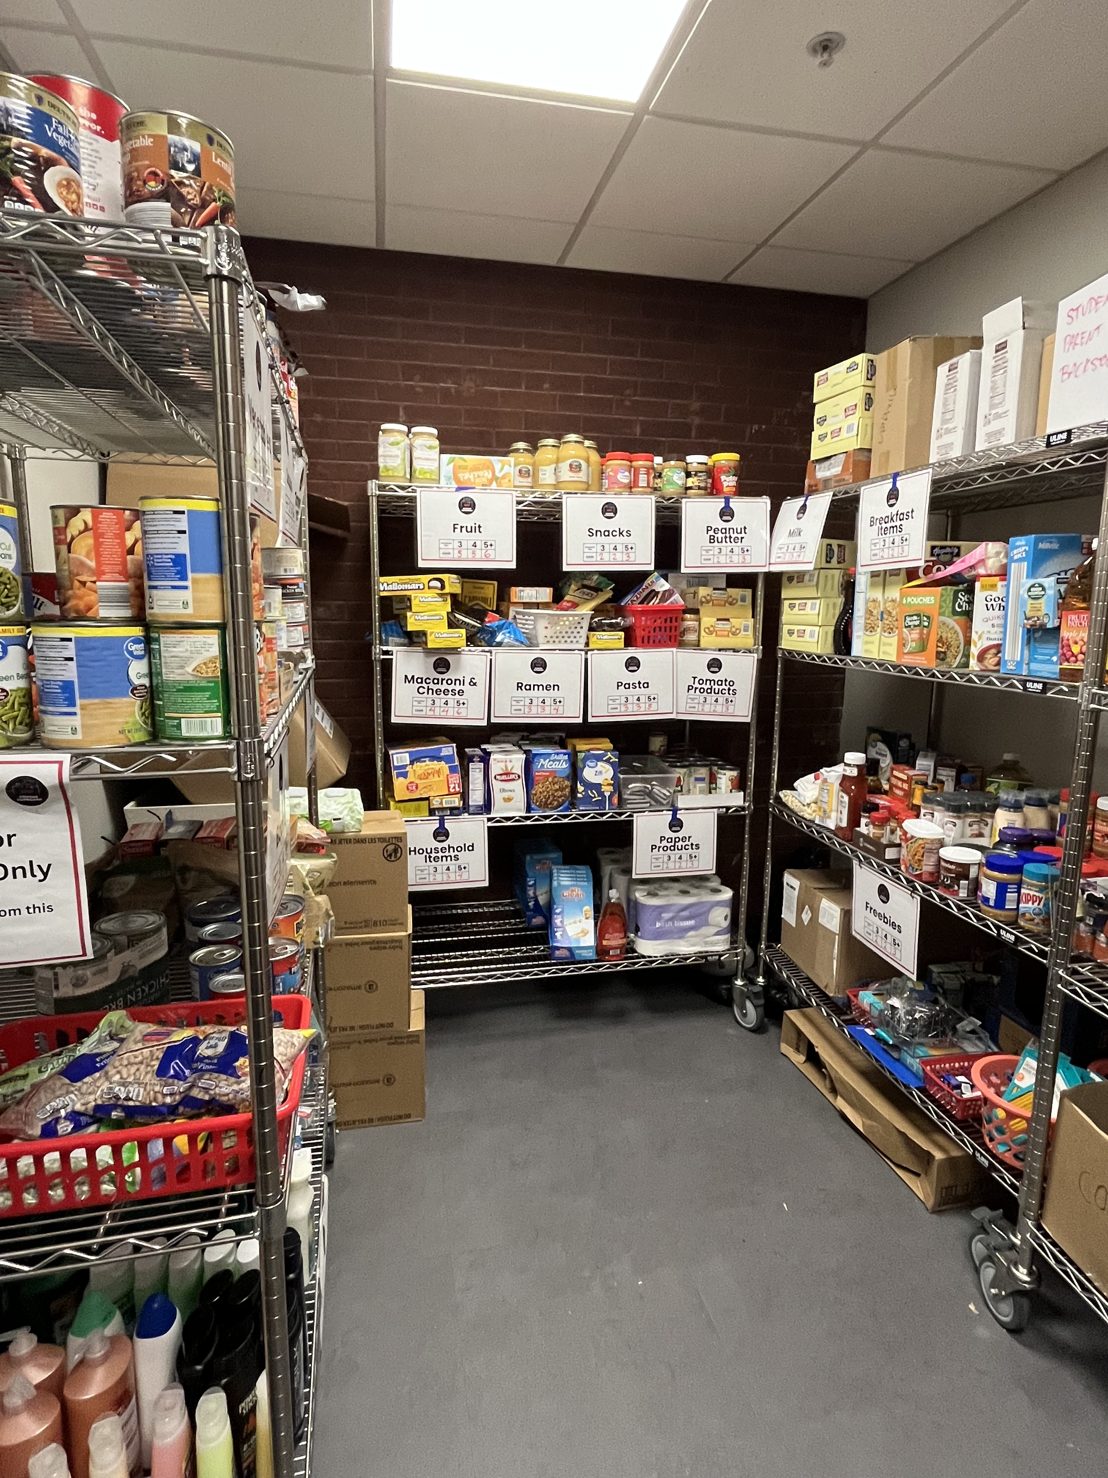
Student Parent Shopping Area
Student-Parent clients are allowed to shop in the back for bulk items on reserve for them
Student-parents are allowed to get more items, depending on their household size.
Signs posted the student-parent shopping area state the number of additional items they are allowed to have
Only student parents are allowed to take diapers, baby wipes, and baby food items
Any bulk items received should be placed in the student-parent shopping section for larger household sizes

Slide 11
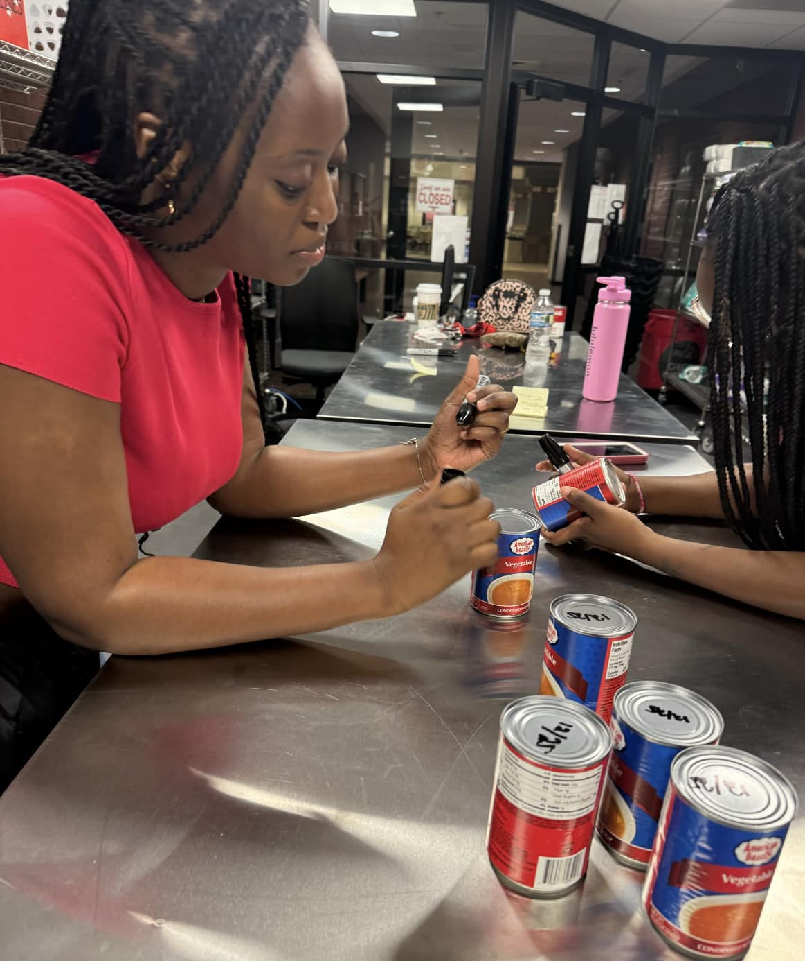
Volunteer Duties: Restocking
If there are no clients to assist, volunteers can restock shelves
Backstock items are typically stored above the shelf it belongs to
Some items may be found in the back storage area (do NOT take items from the parent shelves in the back)
Certain items may be "rationed" due to their limited availability. The supervisor on duty will inform volunteers of any items needing to be rationed.
Volunteer Duties: Miscellaneous
Miscellaneous duties will be directed by the Cougar Cupboard supervisor. Misc tasks may include:
Completing the opening and closing checklist
Repackaging bulk items into smaller quantities
Writing expiration dates on canned goods
Organizing inventory
Restocking Mini Cupboards around campus
Posting flyers around campus

Slide 12
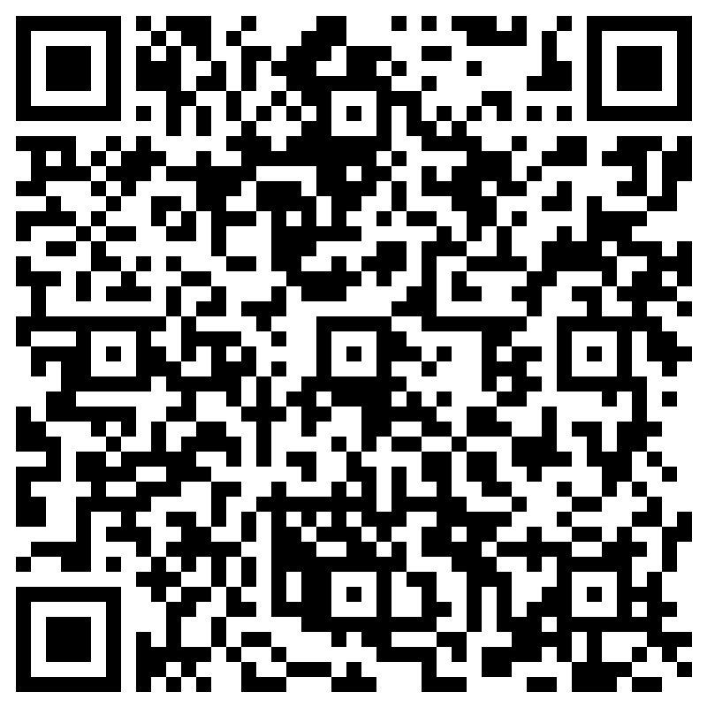
Confidentiality
Confidentiality is super important to the program and to clients to create dignified and safe space for clients in need. Some of what you should NOT be doing include
1. Talk about who you see shopping in the cupboard.
2. Share any personal information
3. Review files
4. Make copies of data or personal information
5. Remove confidential information
6. Identify a client outside the cupboard
If you oversee any of these happening, please inform the supervisor immediately! If you have any questions regarding the confidentiality agreement or what it means before signing it, email cougarcupboard@siue.edu
Before working in the Cougar Cupboard, you must sign the confidentiality agreement. This agreement can be found here:

Slide 13
Quiz
Now it's time to test your knowledge with the volunteer training quiz!
A perfect score is not expected! Any questions missed can be discussed at your first volunteer shift.
This volunteer training is considered complete once the quiz has been taken. If no quiz response is received, you will not be able to volunteer.
https://forms.office.com/Pages/ResponsePage.aspx?id=IX3zmVwL6kORA-FvAvWuz1_yS0aoL8BFmA0kILF3Pc9UNzUwT0VHT0FIMVVHODJYV0o0WThYUDAyNi4u

Slide 14
You have completed the Cougar Cupboard Volunteer training!
Email cougarcupboard@siue.edu with any questions.
We look forward to having you!

